Slide 1
Advance Programming in iOS
Vraj Suratwala
Reference : Multiple AI Platforms

Slide 2
Topics Covered
API Integration
Location Based Services
Core Location Services
CLLocation and CLLocationManager Classes
MapKit, MapView and MLPointAnnotation
Location Based Callouts
Publishing iOS App to Apple App Store
Introduction in SwiftUI

Slide 3
Understaing of API Integration
API Integration in iOS is the process of connecting an iOS application with a remote server using an Application Programming Interface (API) to send and receive data over the internet.
Usage of API Integration:
To fetch data from server (e.g., weather, user data)
To send data (login, signup, forms)
To connect app with backend/database
To enable real-time updates

Slide 4
Common types of an API
oftenly API referes to SOAP and REST API’s.
Type 1 : SOAP (Simple Object Access Protocol - rare in iOS today)
Type 2 : REST (Representational State Transfer)

Slide 5
HTTP Methods used by REST API
GET -> Fetch Data
POST -> Send Data
PUT -> Modify Data
DELETE -> Remove Data

Slide 6
Components to Integrate an API
URL (Endpoint) → API link
HTTP Method → GET, POST, etc.
Headers → authentication, content-type
Request Body → data sent to server
Response → JSON data from server

Slide 7
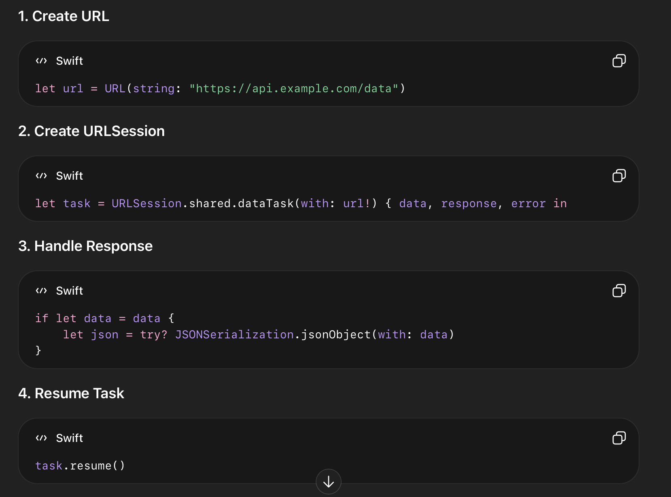
Steps for API Integration

Slide 8
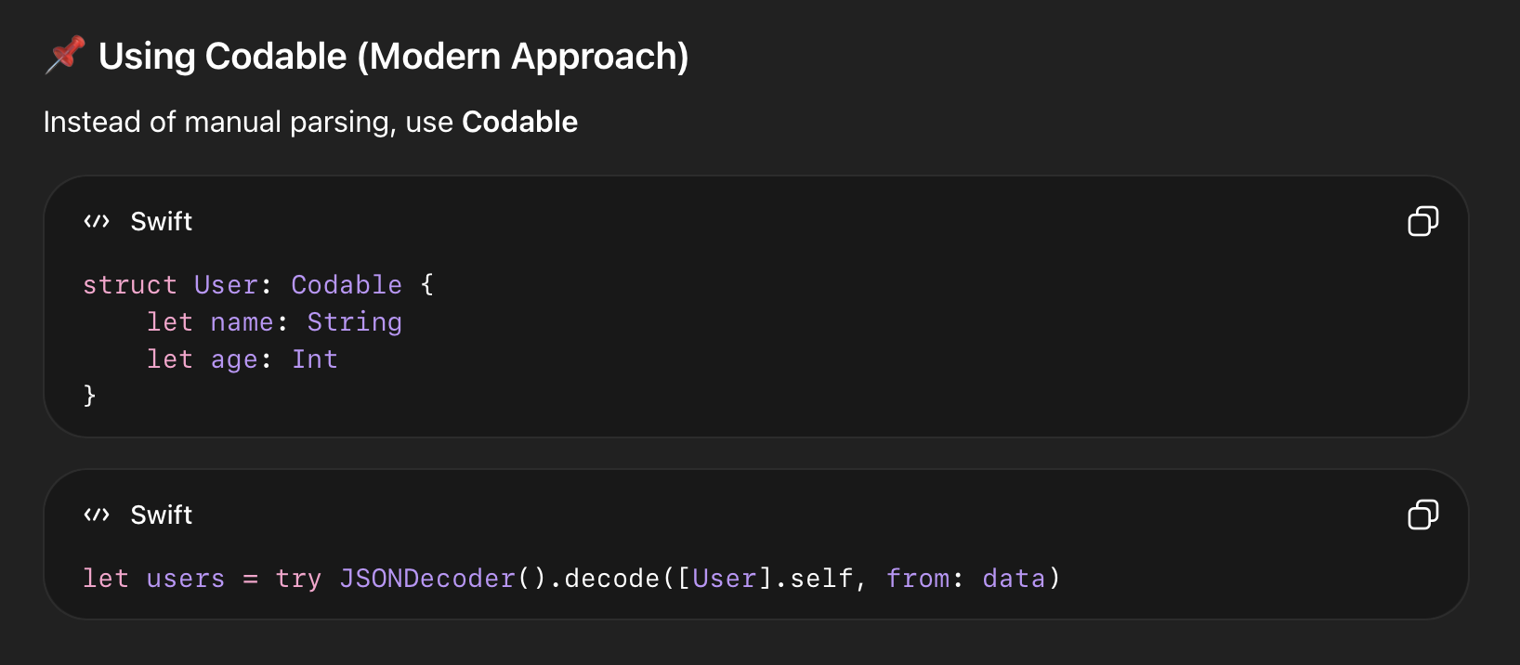
Using That API

Slide 9
GET and POST Request
GET :
URLSession.shared.dataTask(with: url) { data, response, error in
// fetch data
}.resume()
POST :
var request = URLRequest(url: url)
request.httpMethod = "POST"
request.httpBody = try? JSONEncoder().encode(data)
URLSession.shared.dataTask(with: request).resume()

Slide 10
Pro’s and Cons
Advantages :
Real-time data access
Dynamic content
Easy backend connection
Scalable
Disadvantages :
Requires internet
Security risks
Dependency on server

Slide 11
Location Based Services
Location Based Services (LBS) are services in iOS that use the device’s geographic location to provide features like maps, navigation, tracking, and nearby suggestions.
Used to get:
Latitude & Longitude
Speed
Direction
Altitude
Framework name: CoreLocation

Slide 12
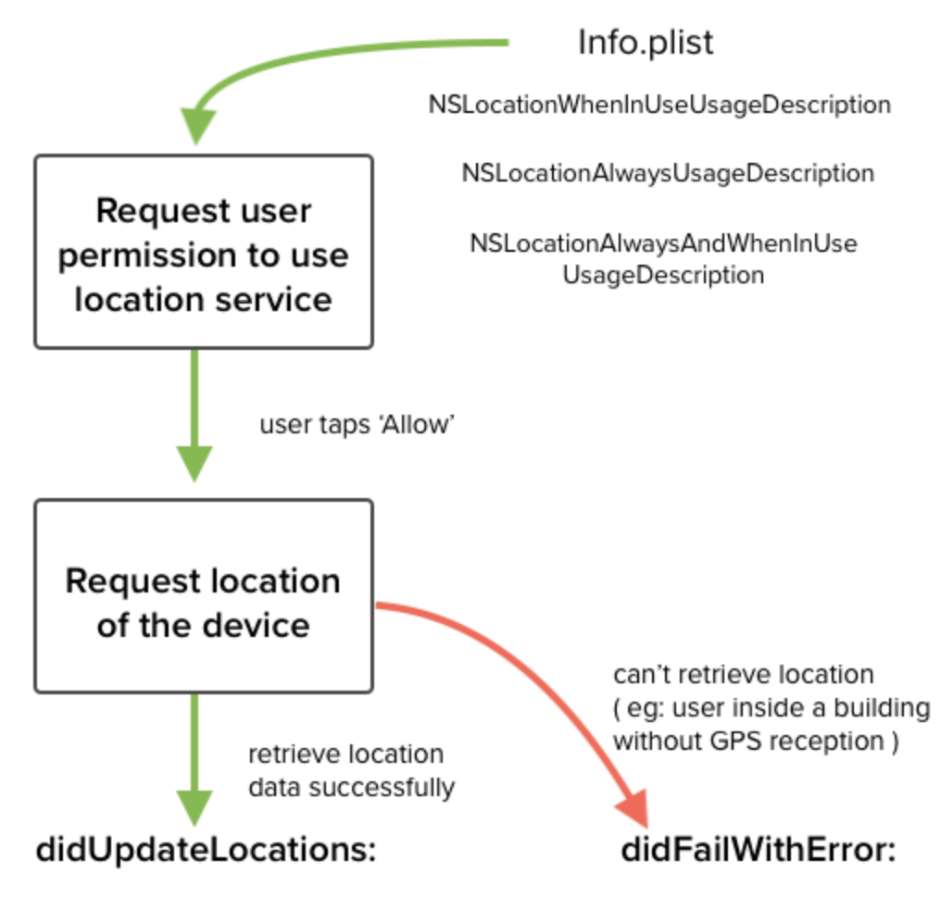
Flow Diagram

Slide 13
CLLocation Class
Represents a specific geographic location
Properties
coordinate → latitude & longitude
altitude → height
speed → movement speed
timestamp → time of location
Example :
let location = CLLocation(latitude: 21.1702, longitude: 72.8311)
print(location.coordinate.latitude)

Slide 14
CLLocationManager Class
Used to manage and receive location updates
Steps to Use this Class :
1. Import Framework
import CoreLocation
2. Create Manager
let locationManager = CLLocationManager()
3. Request Permission
locationManager.requestWhenInUseAuthorization()
4. Start Updating Location
locationManager.startUpdatingLocation()
5. Get Location (Deletegate Method)
func locationManager(_ manager: CLLocationManager, didUpdateLocations locations: [CLLocation]) {
let location = locations.last
}

Slide 15
MapKit Framework
Used to display maps in iOS apps
Works with Core Location
Provides map UI like Apple Maps
Framework: MapKit

Slide 16
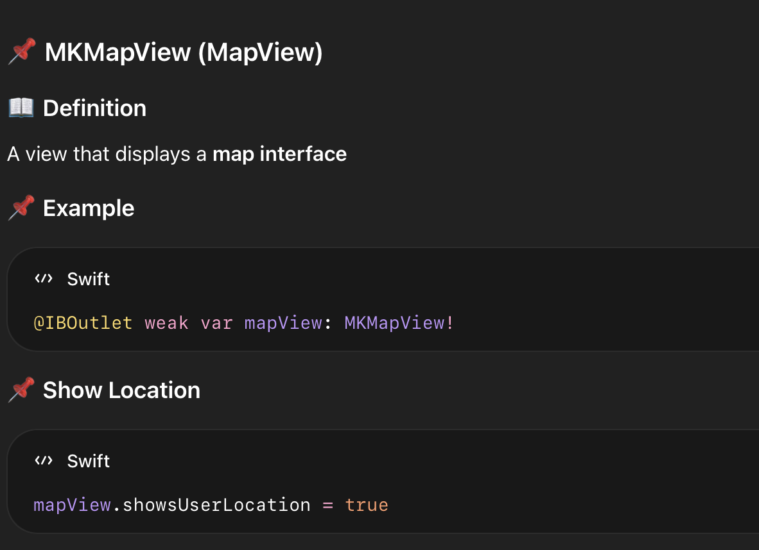
MKMapView (MapView)

Slide 17
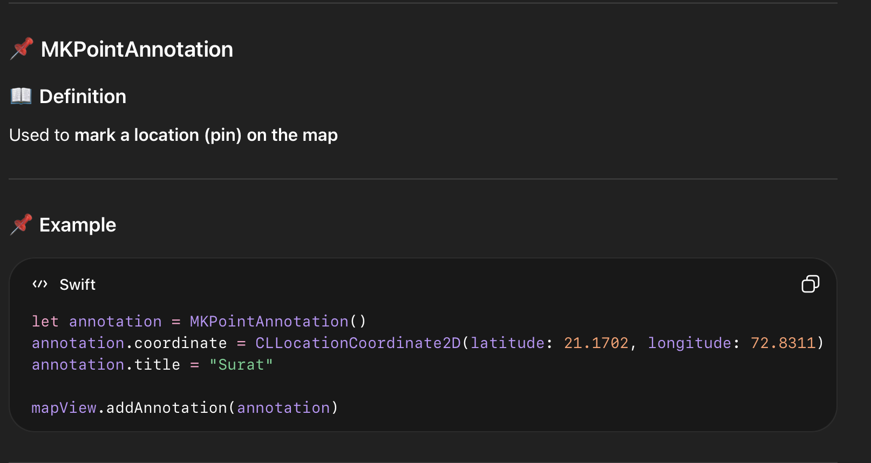
MKPointAnnotation

Slide 18
Location Based Services
A popup bubble that appears when user taps on a map pin
Features
Shows title & subtitle
Can add buttons (info, navigation)
CODE :
annotation.title = "My Location"
annotation.subtitle = "Tap for more info"
NOTE : When user taps pin → callout appears automatically

Slide 19
Impotant Abstraction
CoreLocation → get location
CLLocation → stores location
CLLocationManager → fetch/update location
MapKit → display maps
MKMapView → map UI
MKPointAnnotation → pins
Callouts → info popup

Slide 20
Advantages
Real-time tracking
Navigation support
Personalized services

Slide 21
Disadvantages
Battery consumption
Privacy concerns
Requires permissions

Slide 22
Publishing iOS App to Apple App Store
Publishing an iOS app means deploying and submitting the app to Apple App Store so users can download and install it.
Requirements
Mac system with Xcode
Apple ID
Apple Developer Account ($99/year)
Valid App Bundle Identifier
App icon & screenshots

Slide 23
Steps :
Step 1 : Create App in App Store Connect
Go to App Store Connect
Click → My Apps → + → New App
Enter:
App name
Bundle ID
Language
Step 2 : Prepare App in Xcode
Set: Bundle Identifier
Version & Build number
Fix errors & warnings
Test app properly

Slide 24
Steps :
Steo 3 : Archive the App
Xcode → Product → Archive
Creates a build for upload
Step 4 : Upload App
Use Organizer (Xcode)
Click → Distribute App → App Store Connect → Upload

Slide 25
Steps :
Step 5 : Add App Details
App description
Screenshots
Keywords
Category
Pricing
Step 6 : Submit for Review
Apple reviews app (1–3 days usually)
Must follow App Store Guidelines
Step 7 :App Approval & Release
After approval → Publish manually or automatically
App becomes live on App Store

Slide 26
Introduction in SwiftUI
SwiftUI is a modern UI framework by Apple used to build user interfaces using declarative syntax in Swift.
Declarative UI (just say what, not how)
Live preview
Less code
Cross-platform (iOS, macOS, watchOS)
Automatic dark mode support
CODE :
import SwiftUI
struct ContentView: View {
var body: some View {
Text("Hello, World!")
}
}

Slide 27
SwiftUI
Common UI Components
Text → display text
Image → show images
Button → user interaction
VStack / HStack / ZStack → layouts
VStack {
Text("Welcome")
Button("Click Me") {
print("Tapped")
}
}

Slide 28
Advantages abd Disadvantages
Advantages
Easy to learn
Fast UI development
Real-time preview
Cleaner code
Disadvantages
Limited for older iOS versions
Still evolving
Less control compared to UIKit

Slide 29
Thank You
Vraj Suratwala

